Slide 1
Capstone Project Proposal A Modular and Parallelizable Multi-Agent Reinforcement Learning Framework for Cooperative and Competitive Autonomous Vehicles
AuE-8930 Computing and Simulation for Autonomy
Chinmay Samak
PhD Candidate, CU-ICAR
csamak@clemson.edu
Tanmay Samak
PhD Candidate, CU-ICAR
tsamak@clemson.edu

Slide 2
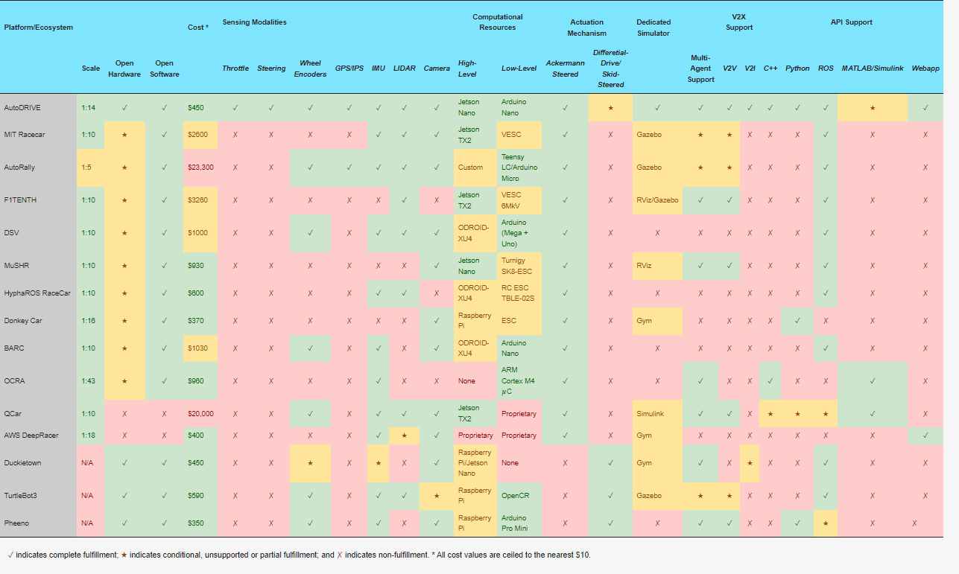
Comparative Analysis of Hardware Platforms
T. Samak, C. Samak, S. Kandhasamy, V. Krovi, and M. Xie, “AutoDRIVE: A Comprehensive, Flexible and Integrated Digital Twin Ecosystem for Autonomous Driving Research & Education,” Robotics, vol. 12, no. 3, p. 77, May 2023, doi: https://doi.org/10.3390/robotics12030077

Slide 3
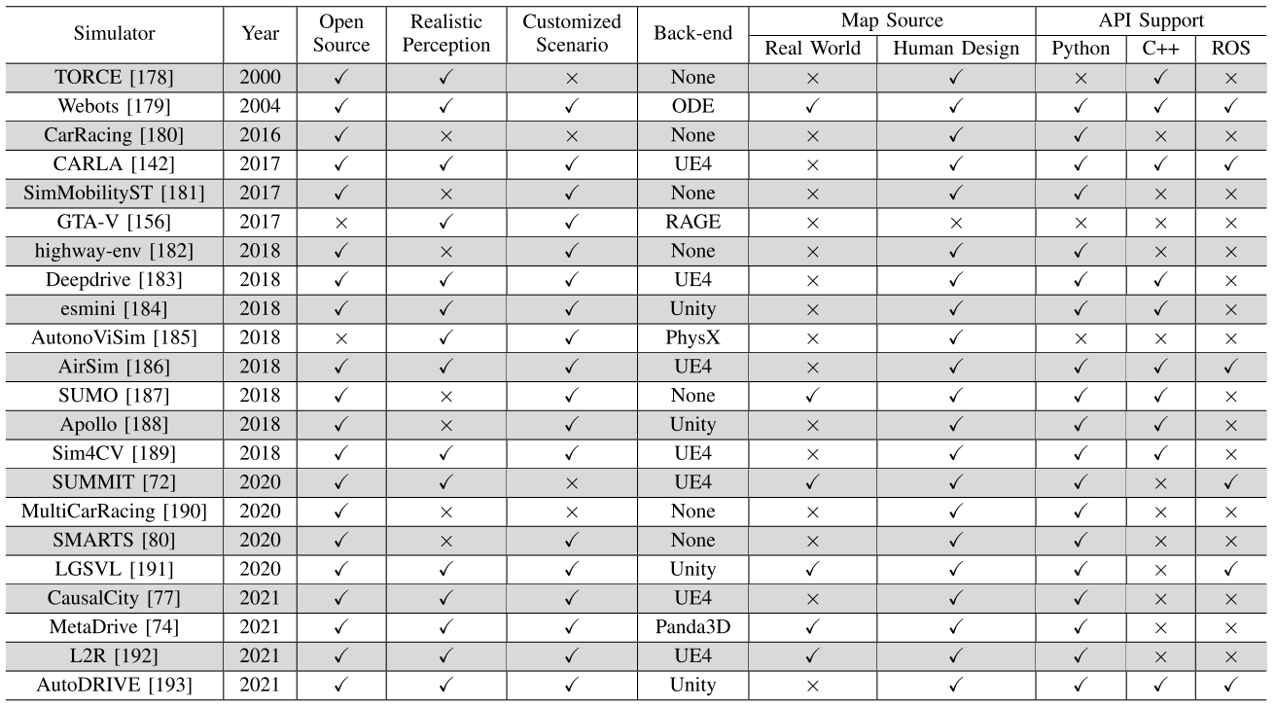
Comparative Analysis of Simulation Platforms
Opportunity!
W. Ding, C. Xu, M. Arief, H. Lin, B. Li and D. Zhao, “A Survey on Safety-Critical Driving Scenario Generation—A Methodological Perspective,” in IEEE Transactions on Intelligent Transportation Systems, vol. 24, no. 7, pp. 6971-6988, July 2023, doi: 10.1109/TITS.2023.3259322

Slide 4
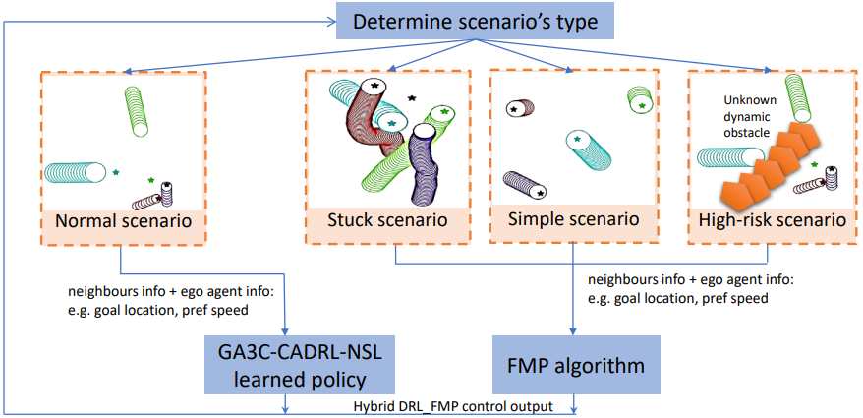
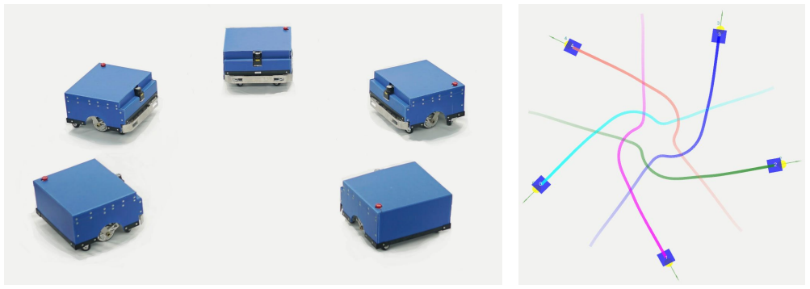
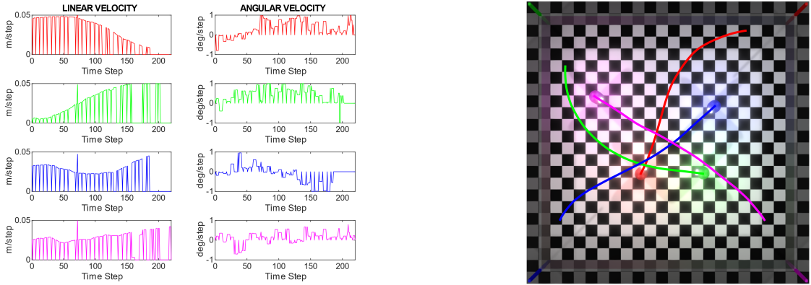
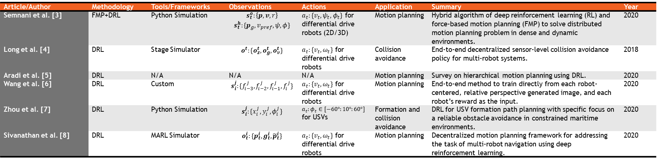
State-of-the-Art: Cooperative DRL
Article/Author | Methodology | Tools/Frameworks | Observations | Actions | Application | Summary | Year
Semnani et al. [3] | FMP+DRL | Python Simulation | $$s_{t}^{o}:\left\{p, v, r\right\}$$ $$s_{t}^{h}:\{p_{g}, v_{pref}, ψ,φ\}$$ | $a_{t}:\{v_{t},ψ_{t},φ_{t}\}$ for differential drive robots (2D/3D) | Motion planning | Hybrid algorithm of deep reinforcement learning (RL) and force-based motion planning (FMP) to solve distributed motion planning problem in dense and dynamic environments. | 2020
Long et al. [4] | DRL | Stage Simulator | $$o^{t}:\{o_{z}^{t},o_{g}^{t},o_{v}^{t}\}$$ | $a_{t}:\{v_{t},ω_{t}\}$ for differential drive robots | Collision avoidance | End-to-end decentralized sensor-level collision avoidance policy for multi-robot systems. | 2018
Aradi et al. [5] | DRL | N/A | N/A | N/A | Motion planning | Survey on hierarchical motion planning using DRL. | 2020
Wang et al. [6] | DRL | Custom | $$s_{i}^{j}:\{f_{i−3}^{j},f_{i−2}^{j},f_{i−1}^{j},f_{i}^{j}\}$$ | $a_{t}:\{v_{t},ω_{t}\}$ for differential drive robots | Motion planning | End-to-end method to train directly from each robot-centered, relative perspective generated image, and each robot’s reward as the input. | 2020
Zhou et al. [7] | DRL | Python Simulation | $$s_{i}^{j}:\{x_{i}^{j},y_{i}^{j},φ_{i}^{j}\}$$ | $a_{t}:φ_{t}∈[−60°:10°:60°]$ for USVs | Formation and collision avoidance | DRL for USV formation path planning with specific focus on a reliable obstacle avoidance in constrained maritime environments. | 2020
Sivanathan et al. [8] | DRL | MARL Simulator | $$o_{t}^{i}:\{p_{t}^{i},g_{t}^{i},{\tilde{p}}_{t}^{i}\}$$ | $a_{t}:\{v_{t},ω_{t}\}$ for differential drive robots | Motion planning | Decentralized motion planning framework for addressing the task of multi-robot navigation using deep reinforcement learning. | 2020
DRL-FMP hybrid control framework [3]
Collision avoidance using DRL [4]
Decentralized motion planning using DRL [8]

Slide 5
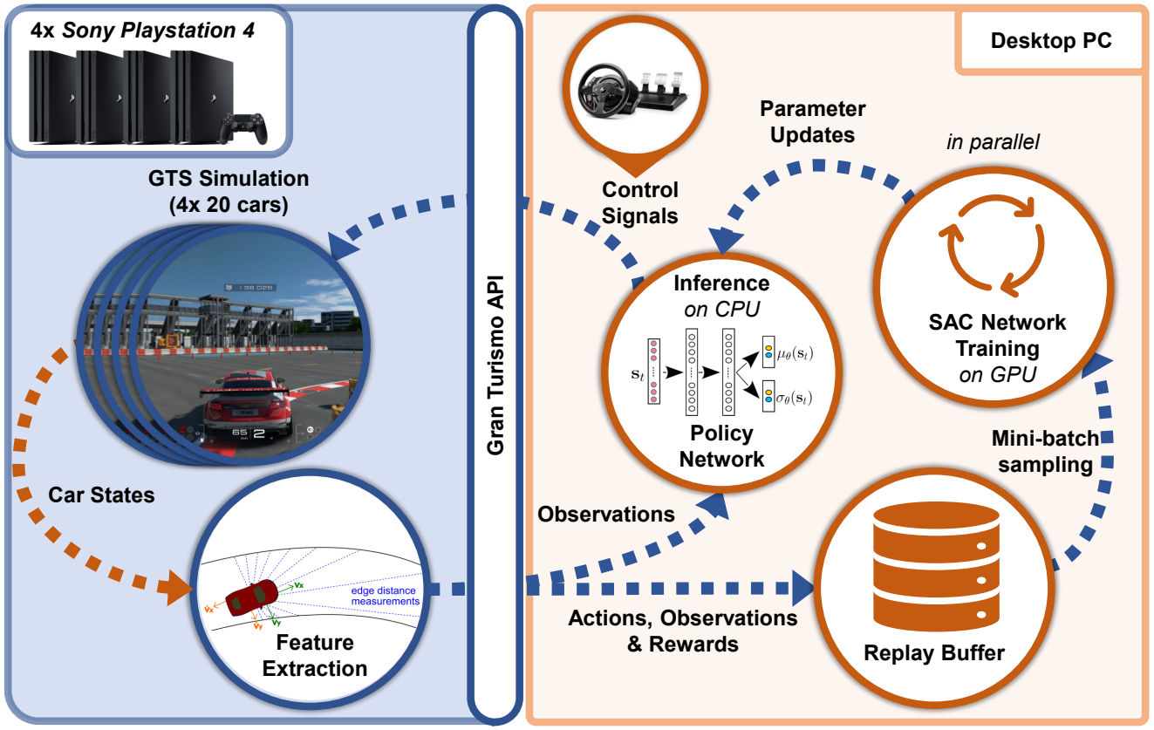
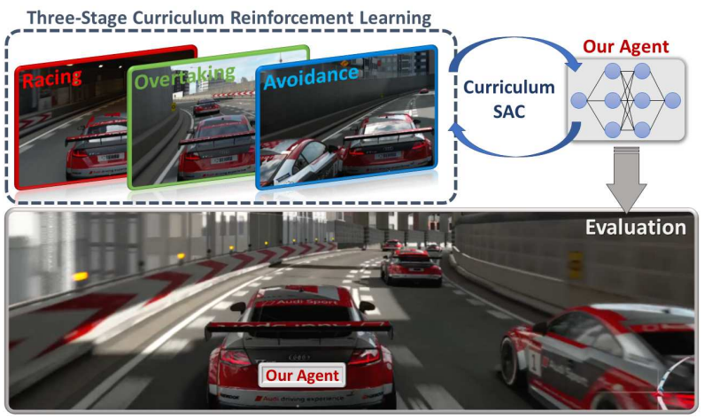
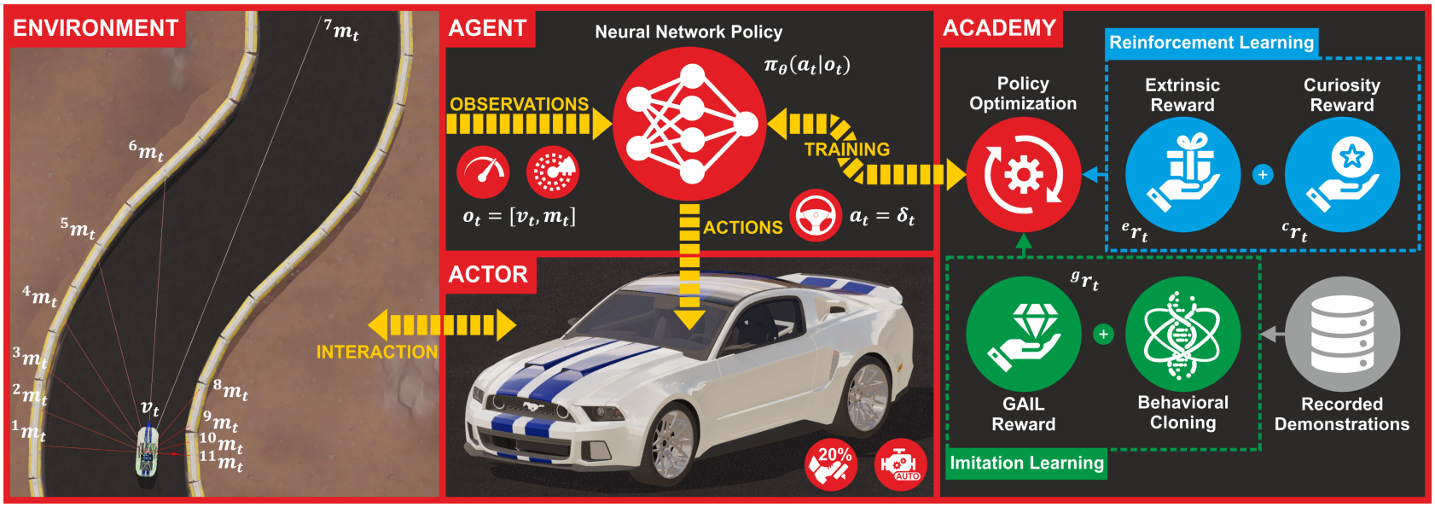
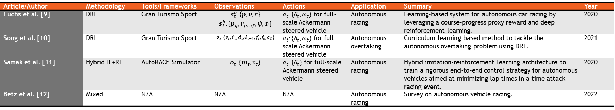
State-of-the-Art: Competitive DRL
Article/Author | Methodology | Tools/Frameworks | Observations | Actions | Application | Summary | Year
Fuchs et al. [9] | DRL | Gran Turismo Sport | $$s_{t}^{o}:\left\{p, v, r\right\}$$ $$s_{t}^{h}:\{p_{g}, v_{pref}, ψ,φ\}$$ | $a_{t}:\{δ_{t},ω_{t}\}$ for full-scale Ackermann steered vehicle | Autonomous racing | Learning-based system for autonomous car racing by leveraging a course-progress proxy reward and deep reinforcement learning. | 2020
Song et al. [10] | DRL | Gran Turismo Sport | $$o_{t}:\{v_{t},{\dot{v}}_{t},d_{t},δ_{t−1},f_{t},f_{c}, c_{L}\}$$ | $a_{t}:\{δ_{t},ω_{t}\}$ for full-scale Ackermann steered vehicle | Autonomous overtaking | Curriculum-learning-based method to tackle the autonomous overtaking problem using DRL. | 2021
Samak et al. [11] | Hybrid IL+RL | AutoRACE Simulator | $$o_{t}:\{m_{t}, v_{t}\}$$ | $a_{t}:\{δ_{t}\}$ for full-scale Ackermann steered vehicle | Autonomous racing | Hybrid imitation-reinforcement learning architecture to train a rigorous end-to-end control strategy for autonomous vehicles aimed at minimizing lap times in a time attack racing event. | 2020
Betz et al. [12] | Mixed | N/A | N/A | N/A | Autonomous racing | Survey on autonomous vehicle racing. | 2022
DRL-FMP hybrid control framework [9]
Autonomous overtaking using DRL [10]
Hybrid IL+RL architecture for autonomous racing [11]

Slide 6



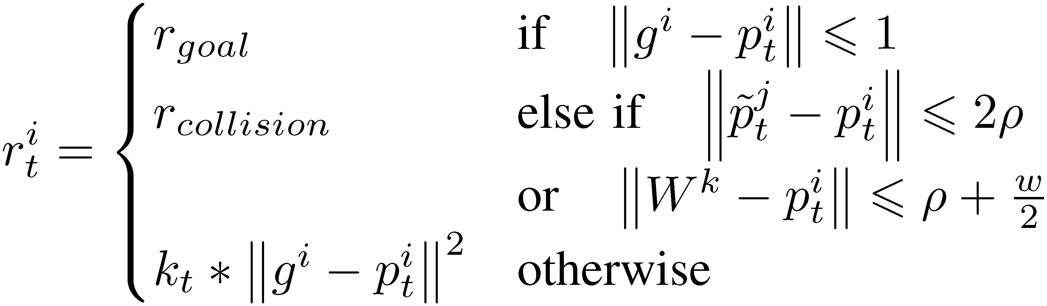
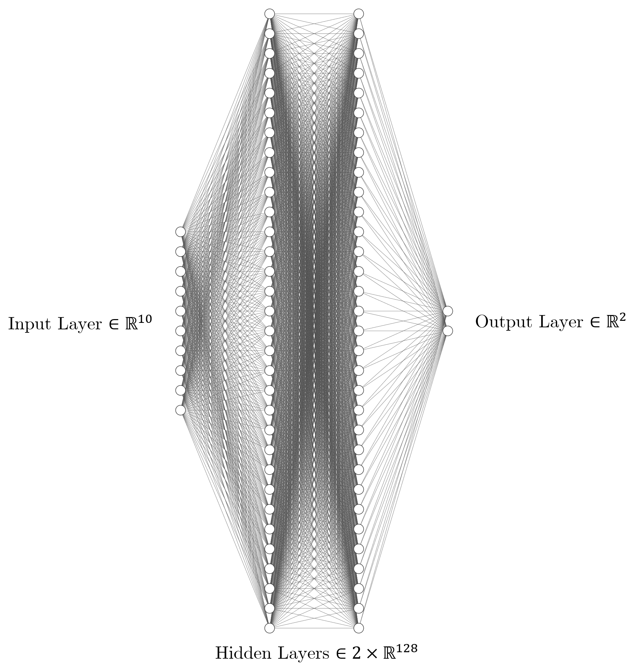
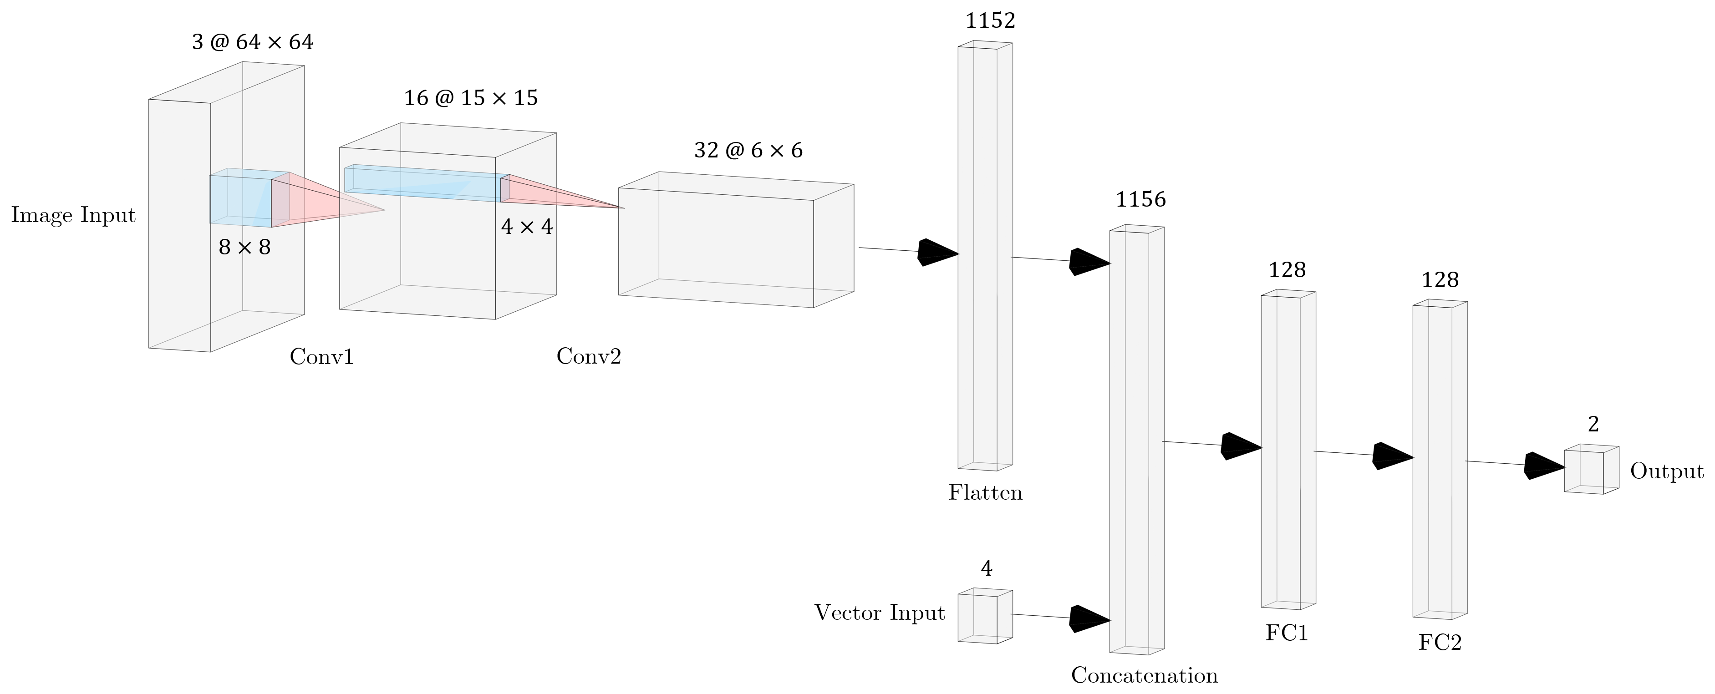
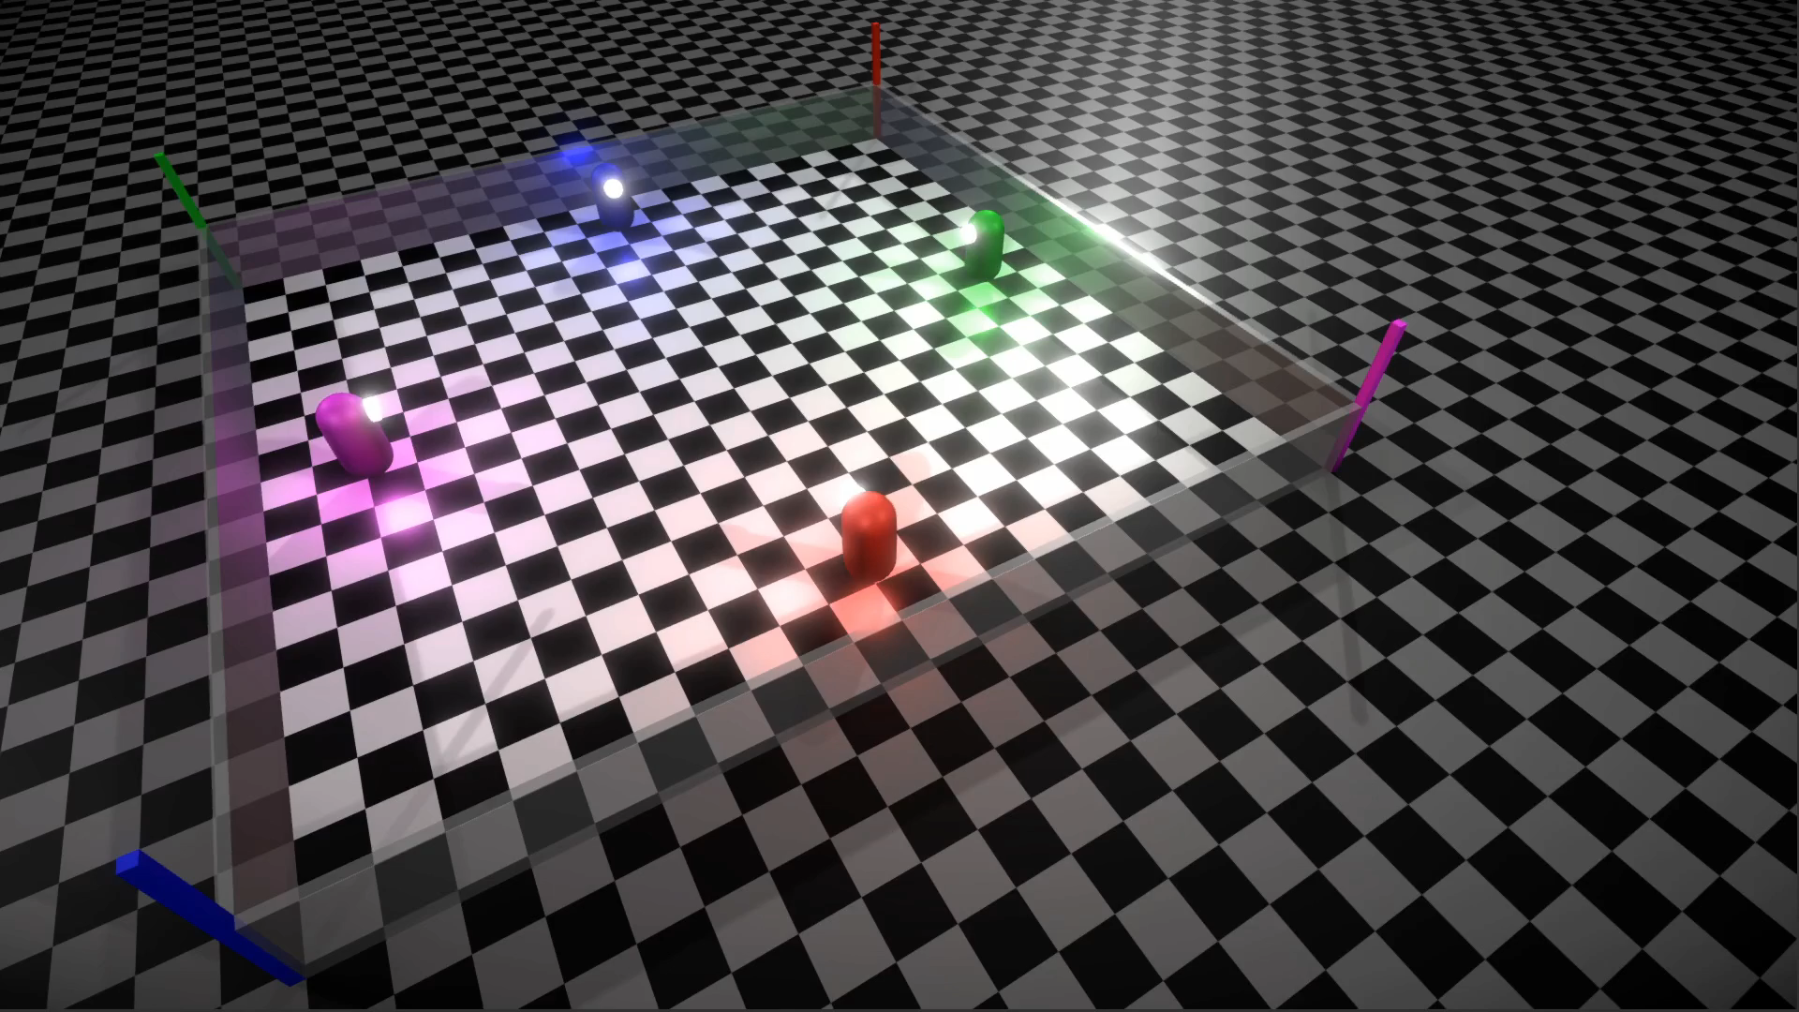
Baseline: Multi-Robot Navigation using DRL
Title: Decentralized Motion Planning for Multi-Robot Navigation using Deep Reinforcement Learning
Publication: International Conference on Intelligent Sustainable Systems, 2020; 709-716, DOI: 10.1109/ICISS49785.2020.9316033
Novel contribution and findings:
MARL Simulator
Novel reward function for efficient learning
Robust testing in 4 stochastic settings using 2 training approaches
Deployment on cooperative as well as non-cooperative agents
G2GCA
APE
G2GCARI
VAG2GCA
Cooperative Agents
Non-Cooperative Agents
Cooperative Agents
Non-Cooperative Agents

Slide 7
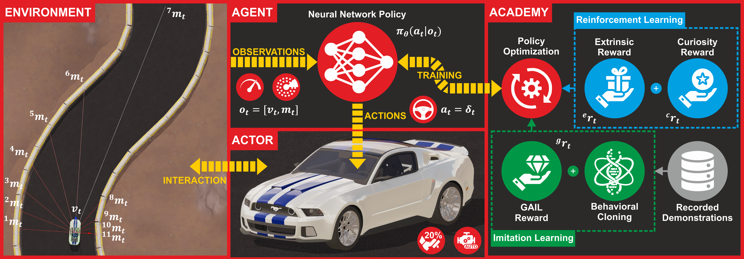
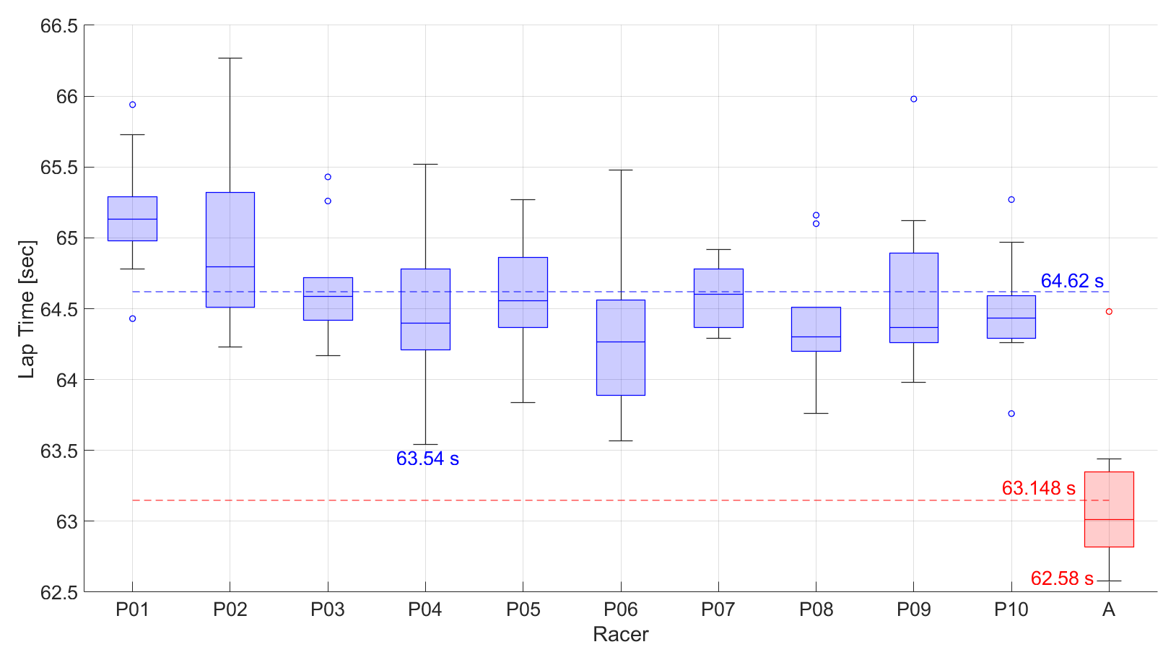
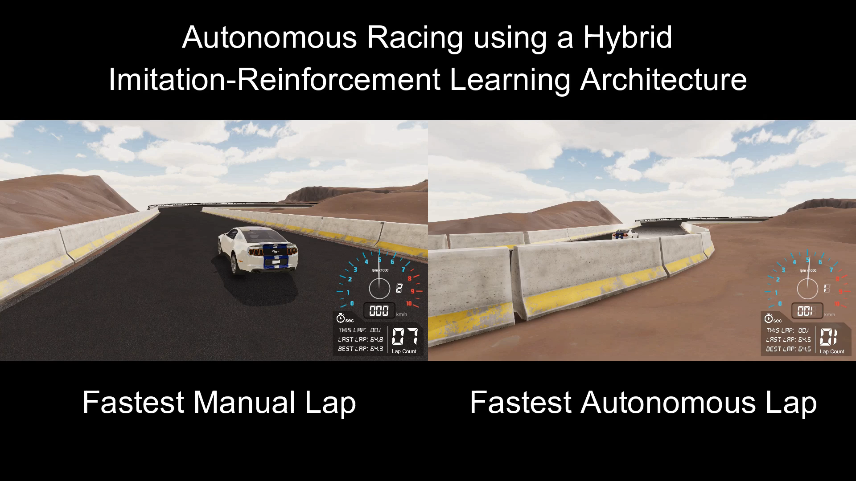
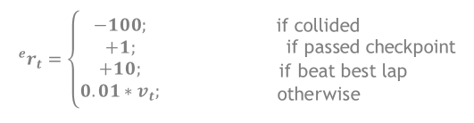
Baseline: Autonomous Racing using IL+RL
Title: Autonomous Racing using a Hybrid Imitation-Reinforcement Learning Architecture
Publication: Submitted to Robotics and Autonomous Systems, Elsevier, 2021
Novel contribution and findings:
AutoRACE Simulator
Realistic observation and action spaces (sim2real)
Hybrid learning architecture and novel reward function
Superhuman racing performance
Time Attack Race Results
Fastest Manual Lap
Fastest Autonomous Lap
Observation Space:
$$o_{t}=\left[v_{t}, m_{t}\right]∈ℝ^{12}; v_{t}∈ ℝ^{1} \text{and} m_{t}∈ℝ^{11}$$
Action Space:
$$a_{t}=δ_{t}∈ℝ^{1}; { δ}_{t}∈\{−1, 0, 1\}$$
Extrinsic Reward Function:
$$^{e}r_{t}=\left\{\begin{aligned}−100; \\ +1; \\ +10; \\ 0.01∗v_{t};\end{aligned}\right.$$ | $${\begin{aligned} \\ \text{if} \text{collided} \\ \text{if} \text{passed} \text{checkpoint}\end{aligned} \atop \begin{aligned} \text{i}\text{f} \text{beat} \text{best} \text{lap} \\ \text{otherwise}\end{aligned}}$$

Slide 8

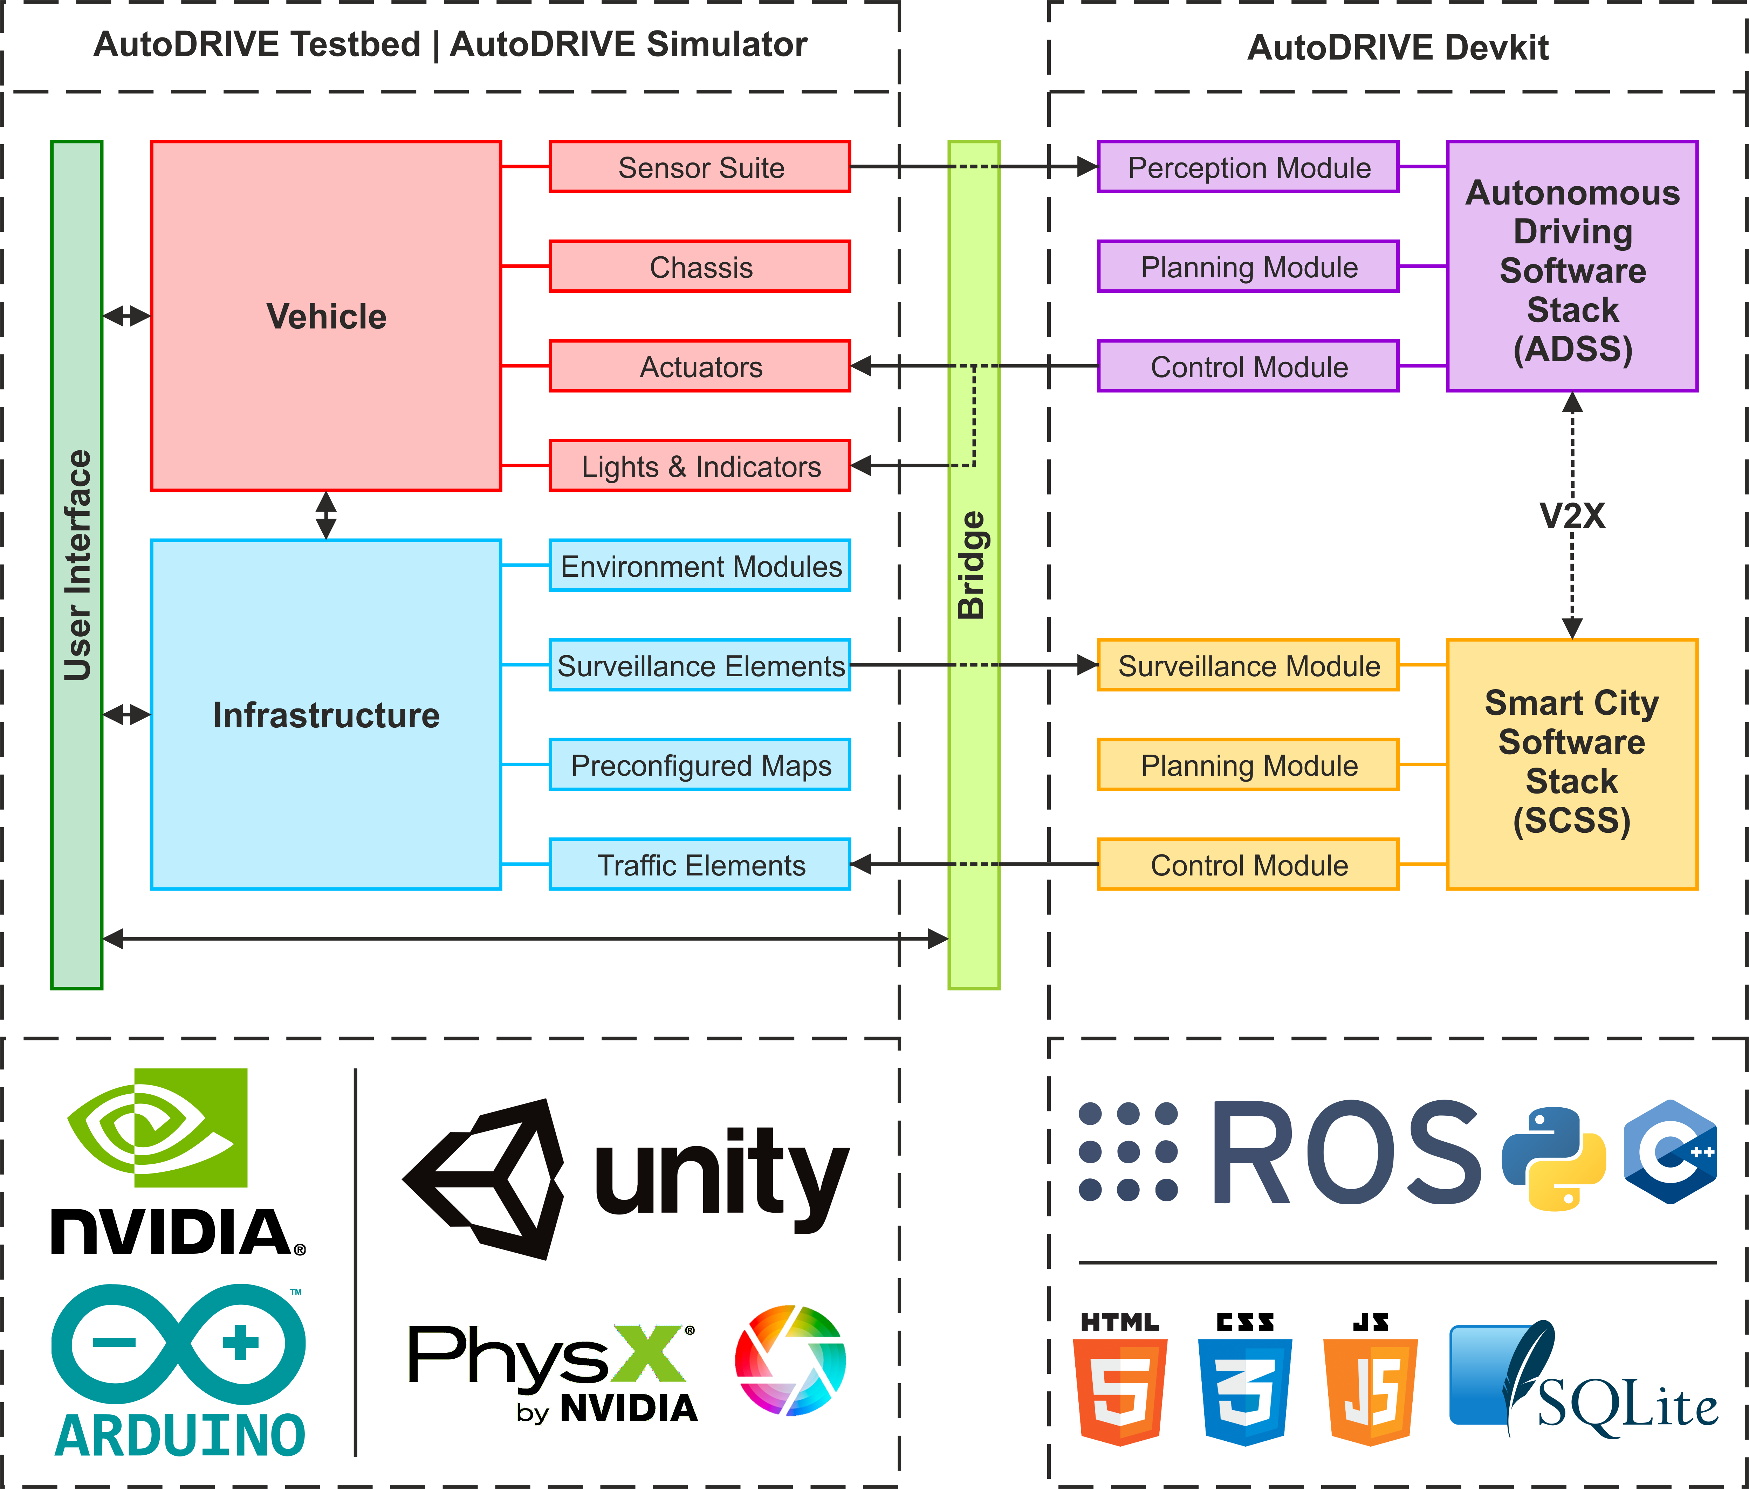
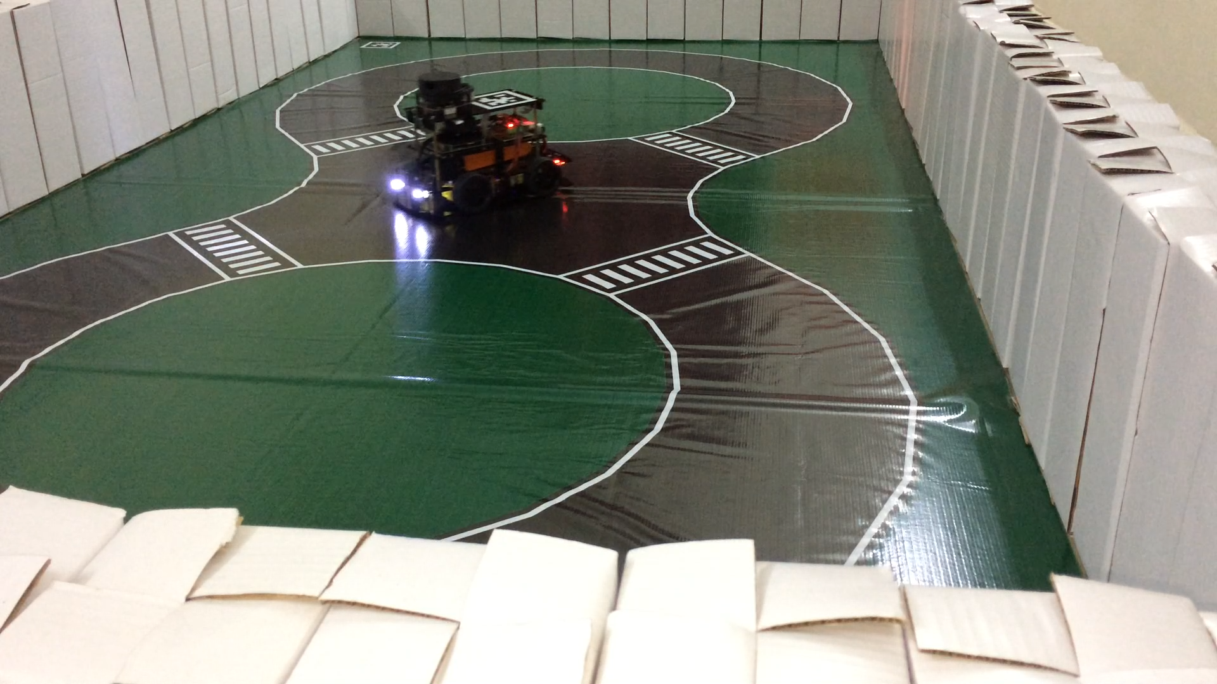
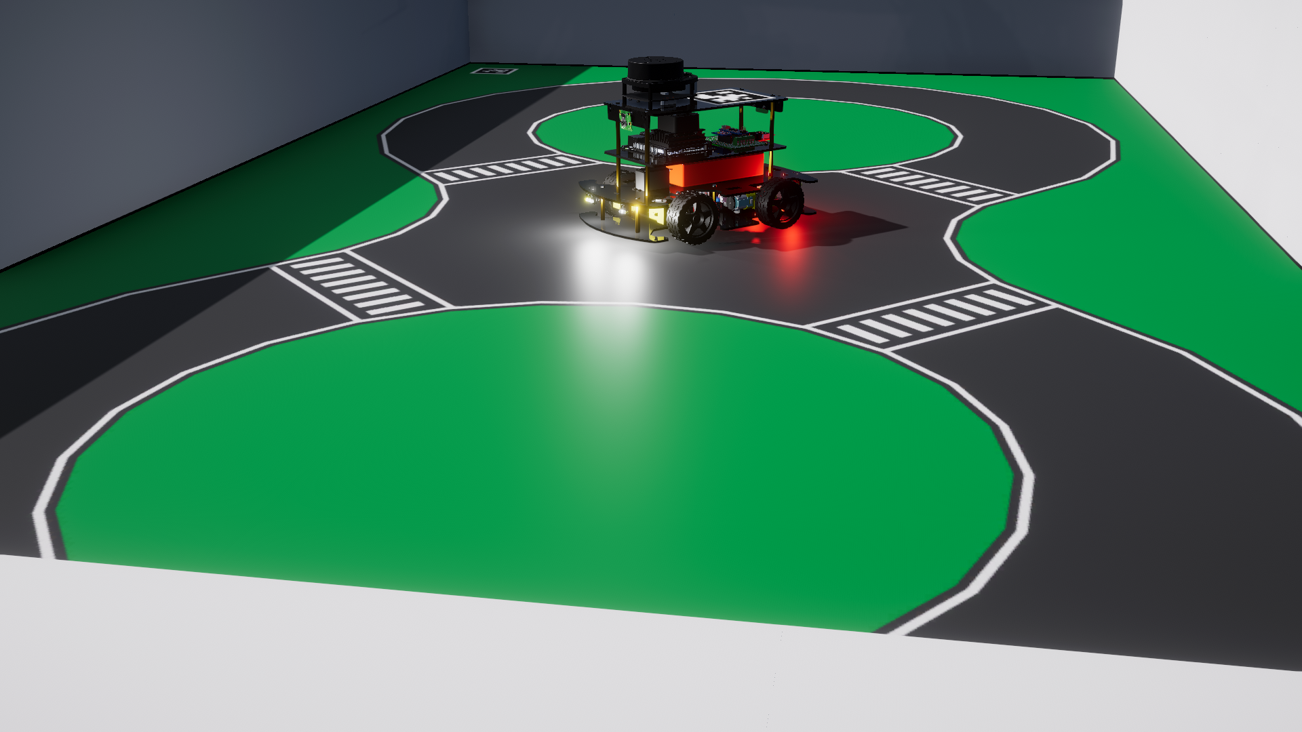
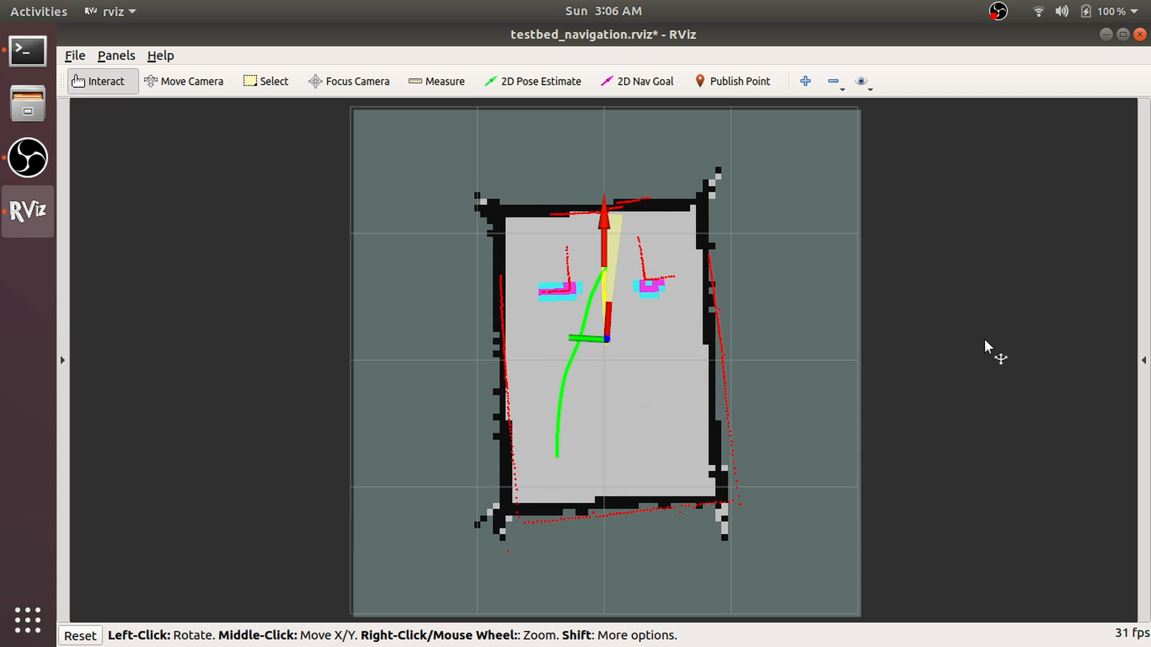
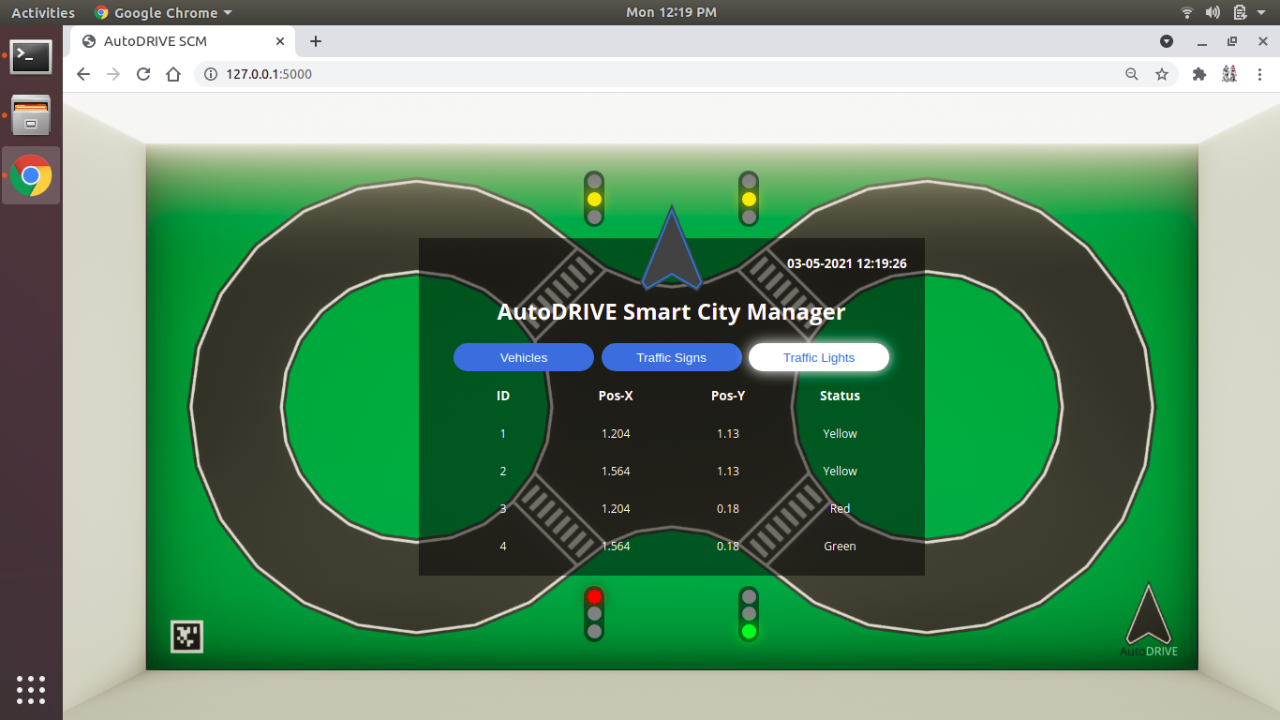

AutoDRIVE Ecosystem
Website
GitHub
YouTube
Ackermann-steer, skid-steer, independent 4WD4WS
1/14 scale open chassis
Scaled infrastructure
Small form factor
Flexible APIs
High-fidelity simulation
Mechatronic testbed
AD + SC applications
Affordable cost
Version | Mobile Base | Battery | Computer(s) | Sensor(s) | Actuator(s) | Developer | Release | Cost
Nigel | Open-Source | 5200 mAh | Jetson Nano or Jetson Orin Nano | RPLIDAR A-1, Pi-Cameras, Intel RealSense D435i, 9-Axis IMU, 6-Axis IPS, Encoders, Microphone, Steering Feedback, Throttle Feedback | DC Motors, Steering Servo(s) | CU-ICAR + NTU + SRMIST | 2021 | $450
=
Source: https://autodrive-ecosystem.github.io

Slide 9
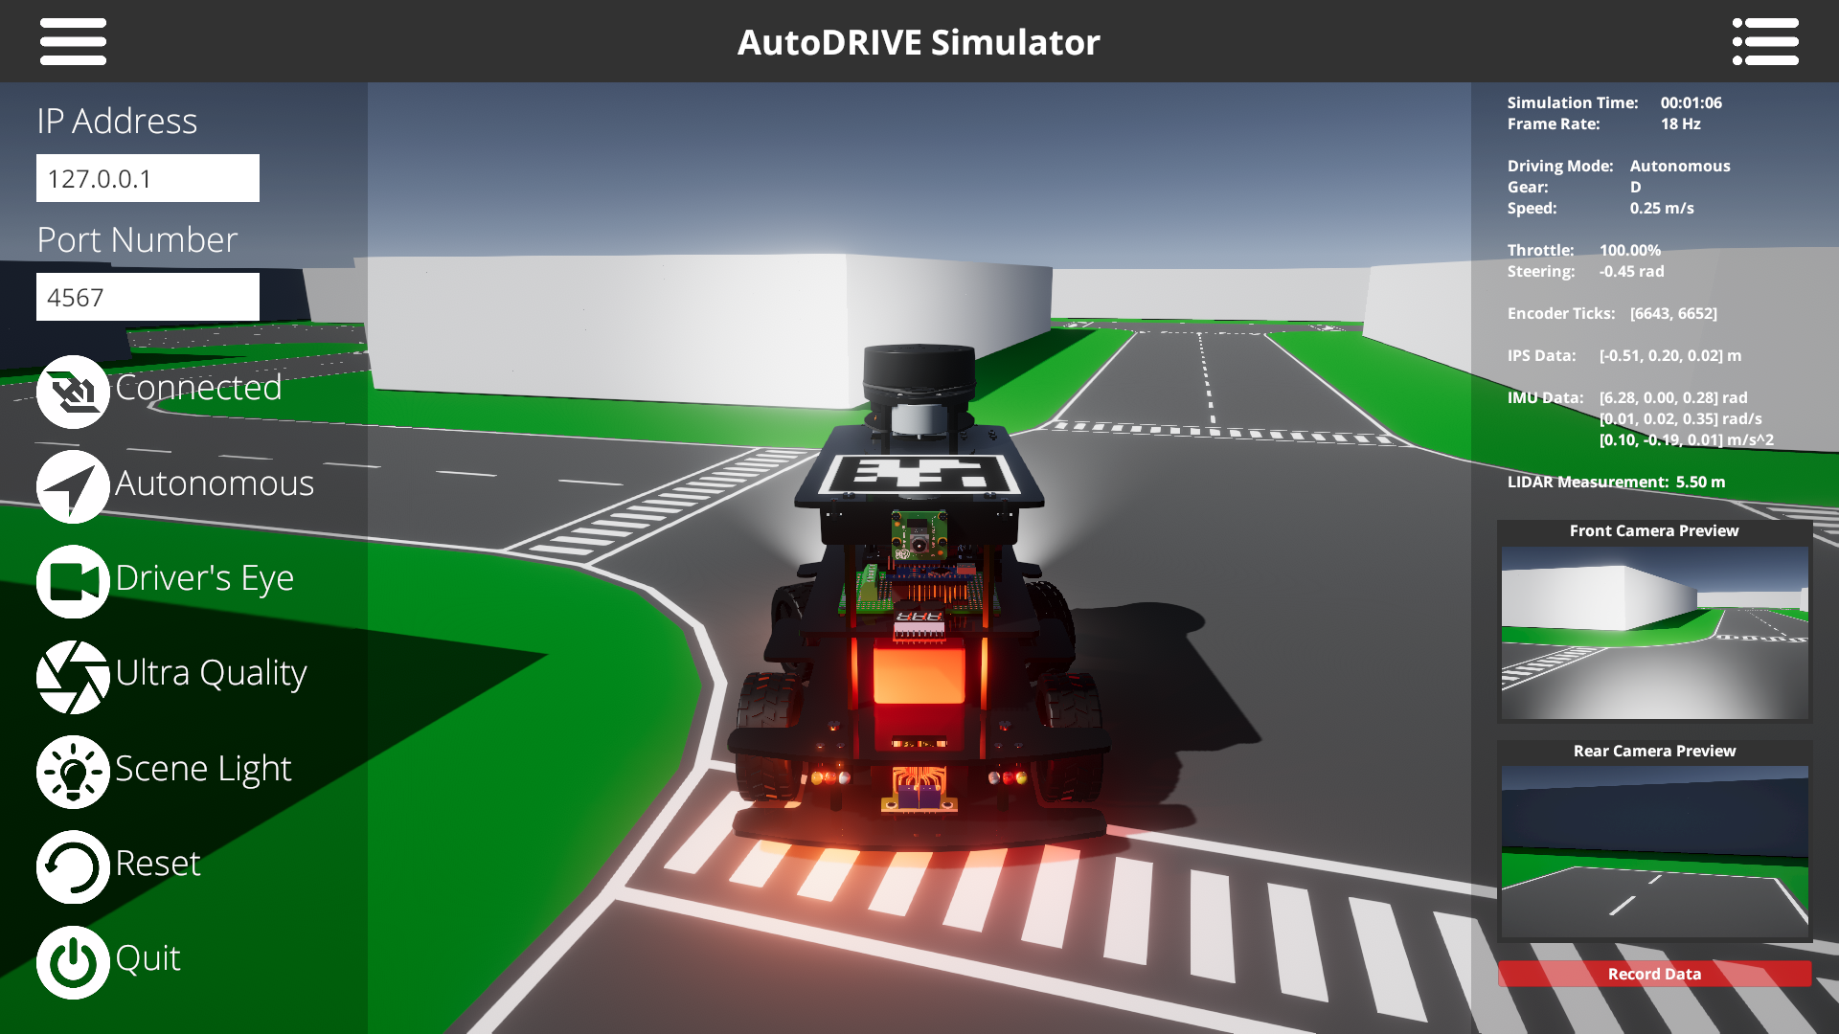
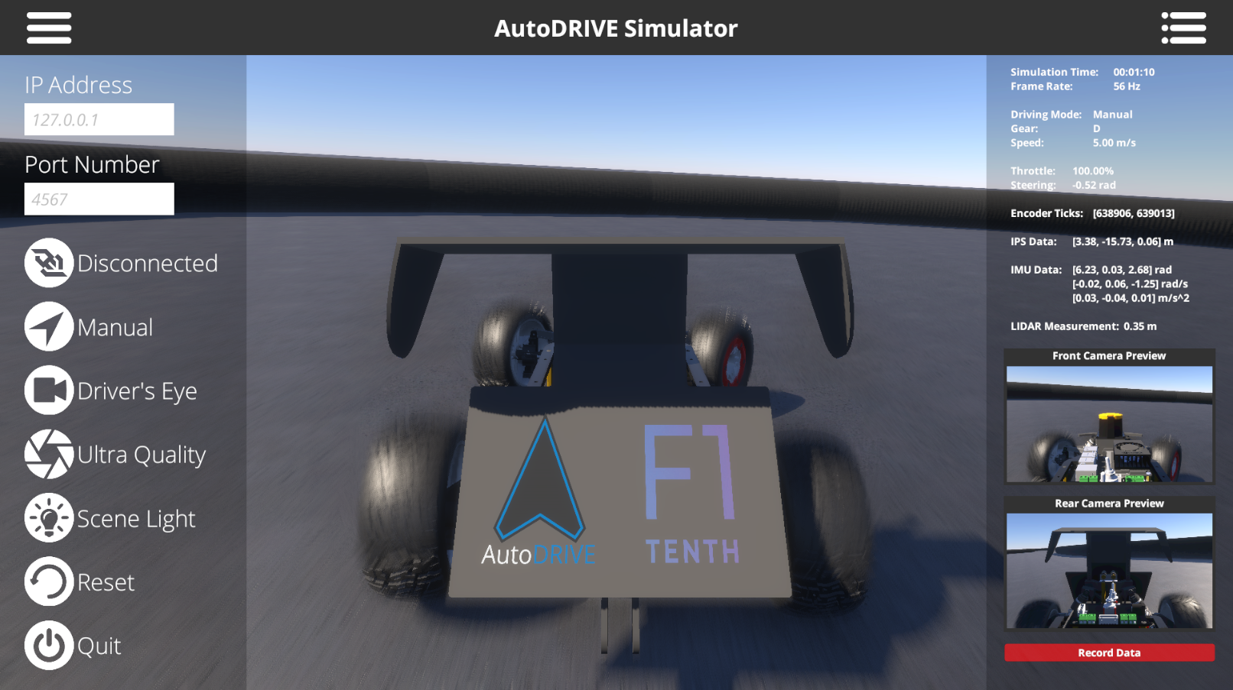
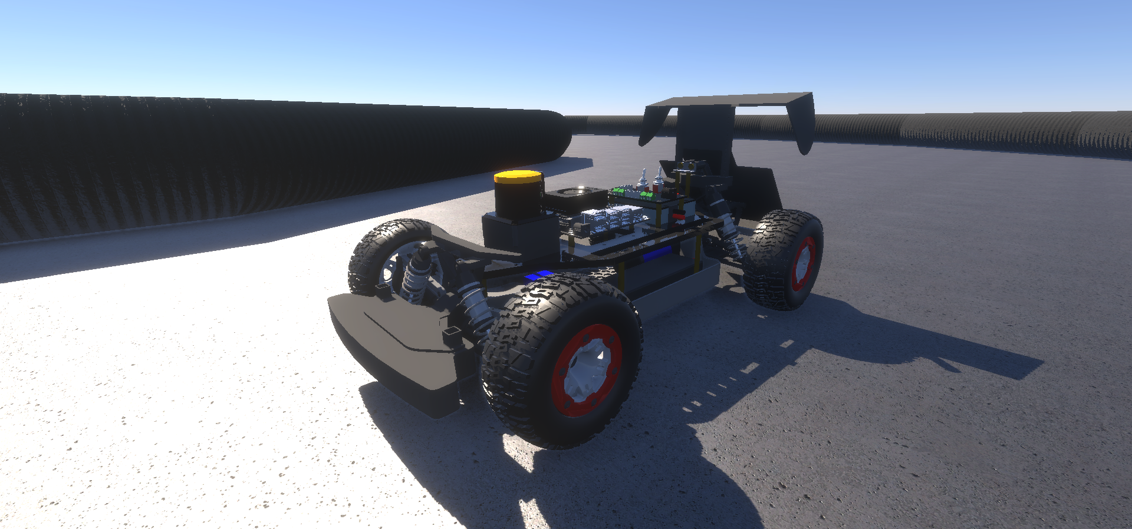
AutoDRIVE Simulator
Advantages
3D simulation environment
Photorealistic graphics
Realistic physics
Cross-platform support
Extended API support
On/off road AVs across scales
Disadvantages
Moderate compute requirements
Small development team
Source: AutoDRIVE Ecosystem
Simulation Quality | Physics Engine | Graphics Rendering | Vehicle Dynamics Support | Sensor Support | API Support | Developer | Cost | Open Source | Applications
3D | PhysX | Unity HDRP | Full car model for lateral, longitudinal, vertical and RPY dynamics with tire-terrain interaction | 2D/3D LIDAR, Camera, GNSS, IPS, IMU, Encoders Steering Feedback, Throttle Feedback, State Variables | ROS, ROS 2, Python, C++, MATLAB, Simulink, Webapp | CU-ICAR, NTU, SRMIST | Free | Yes | Exploration, education and research

Slide 10
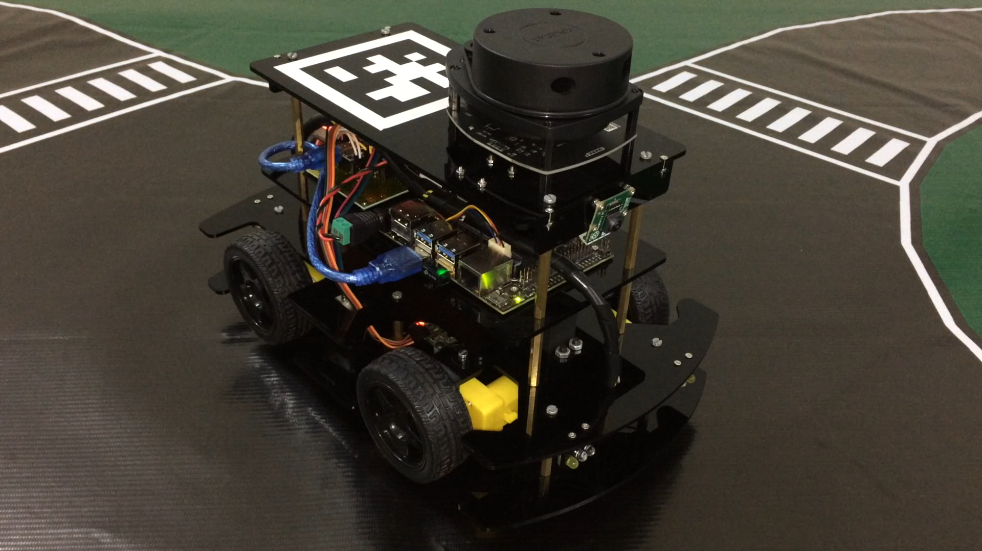
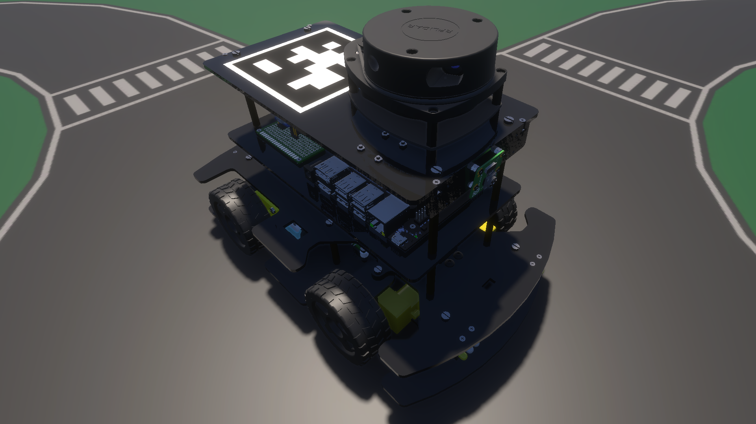
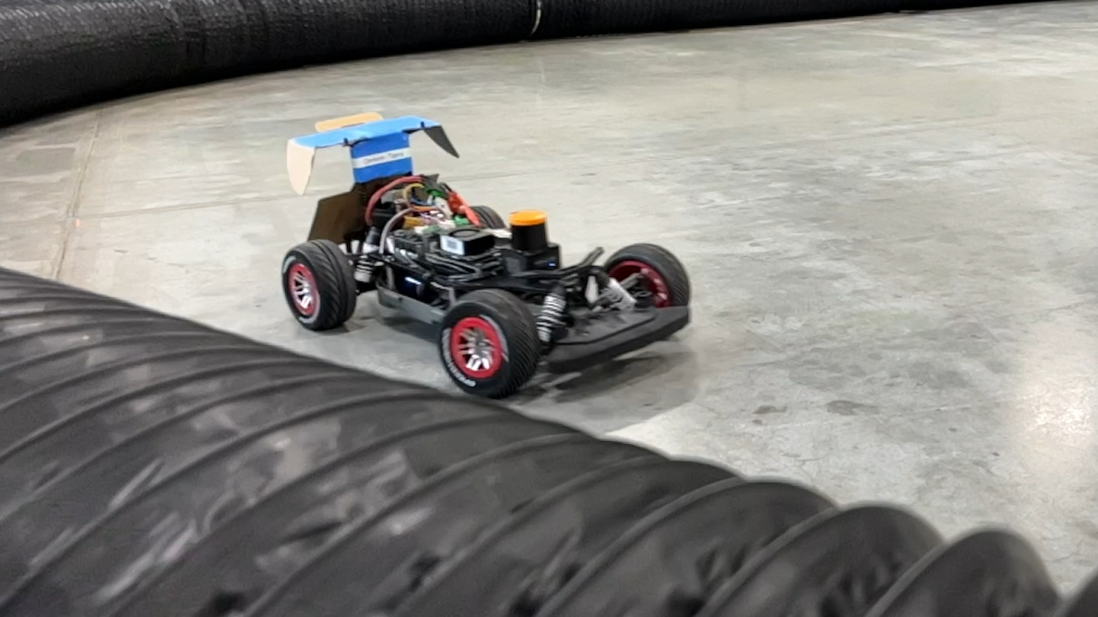
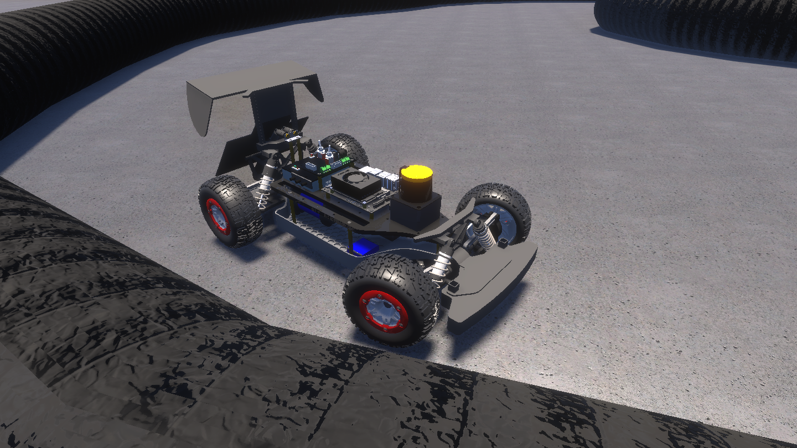
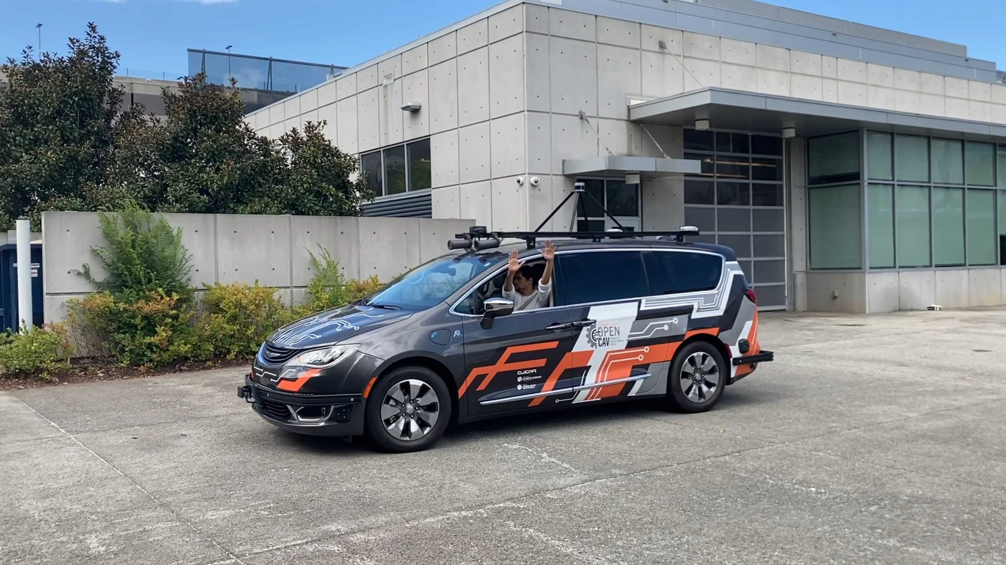
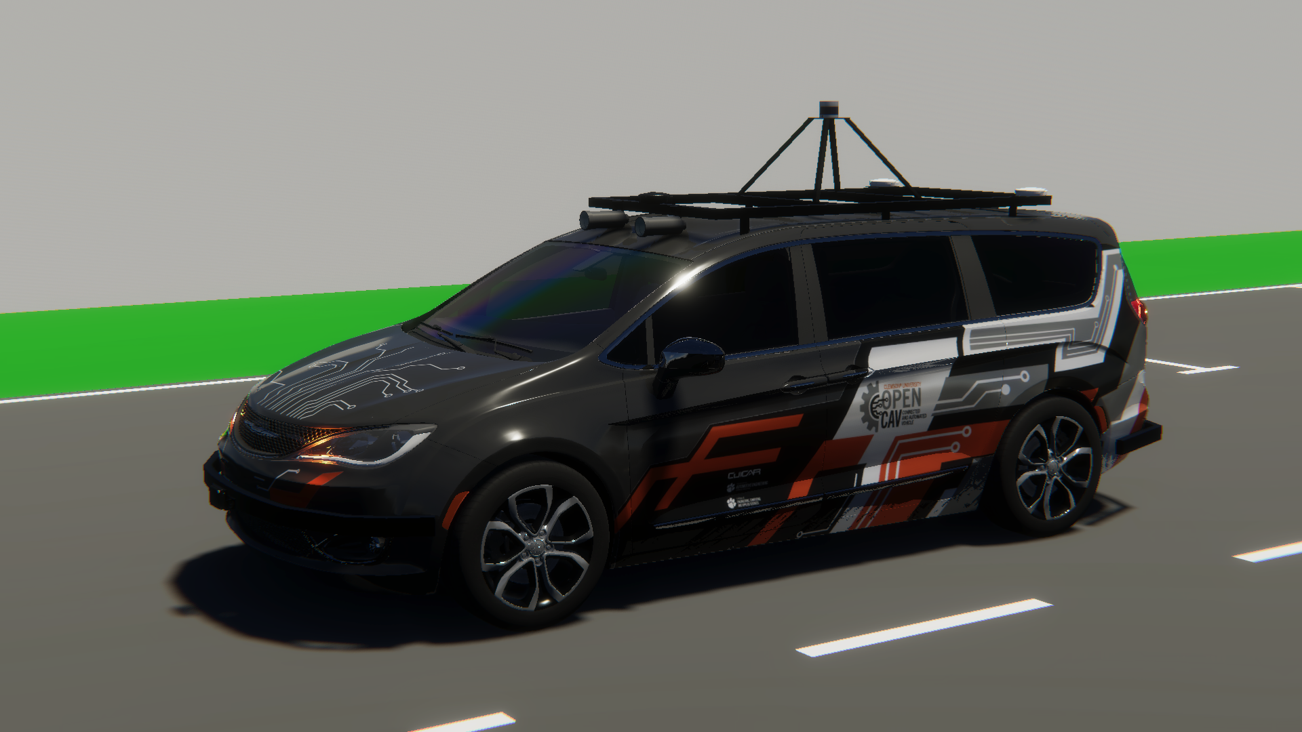
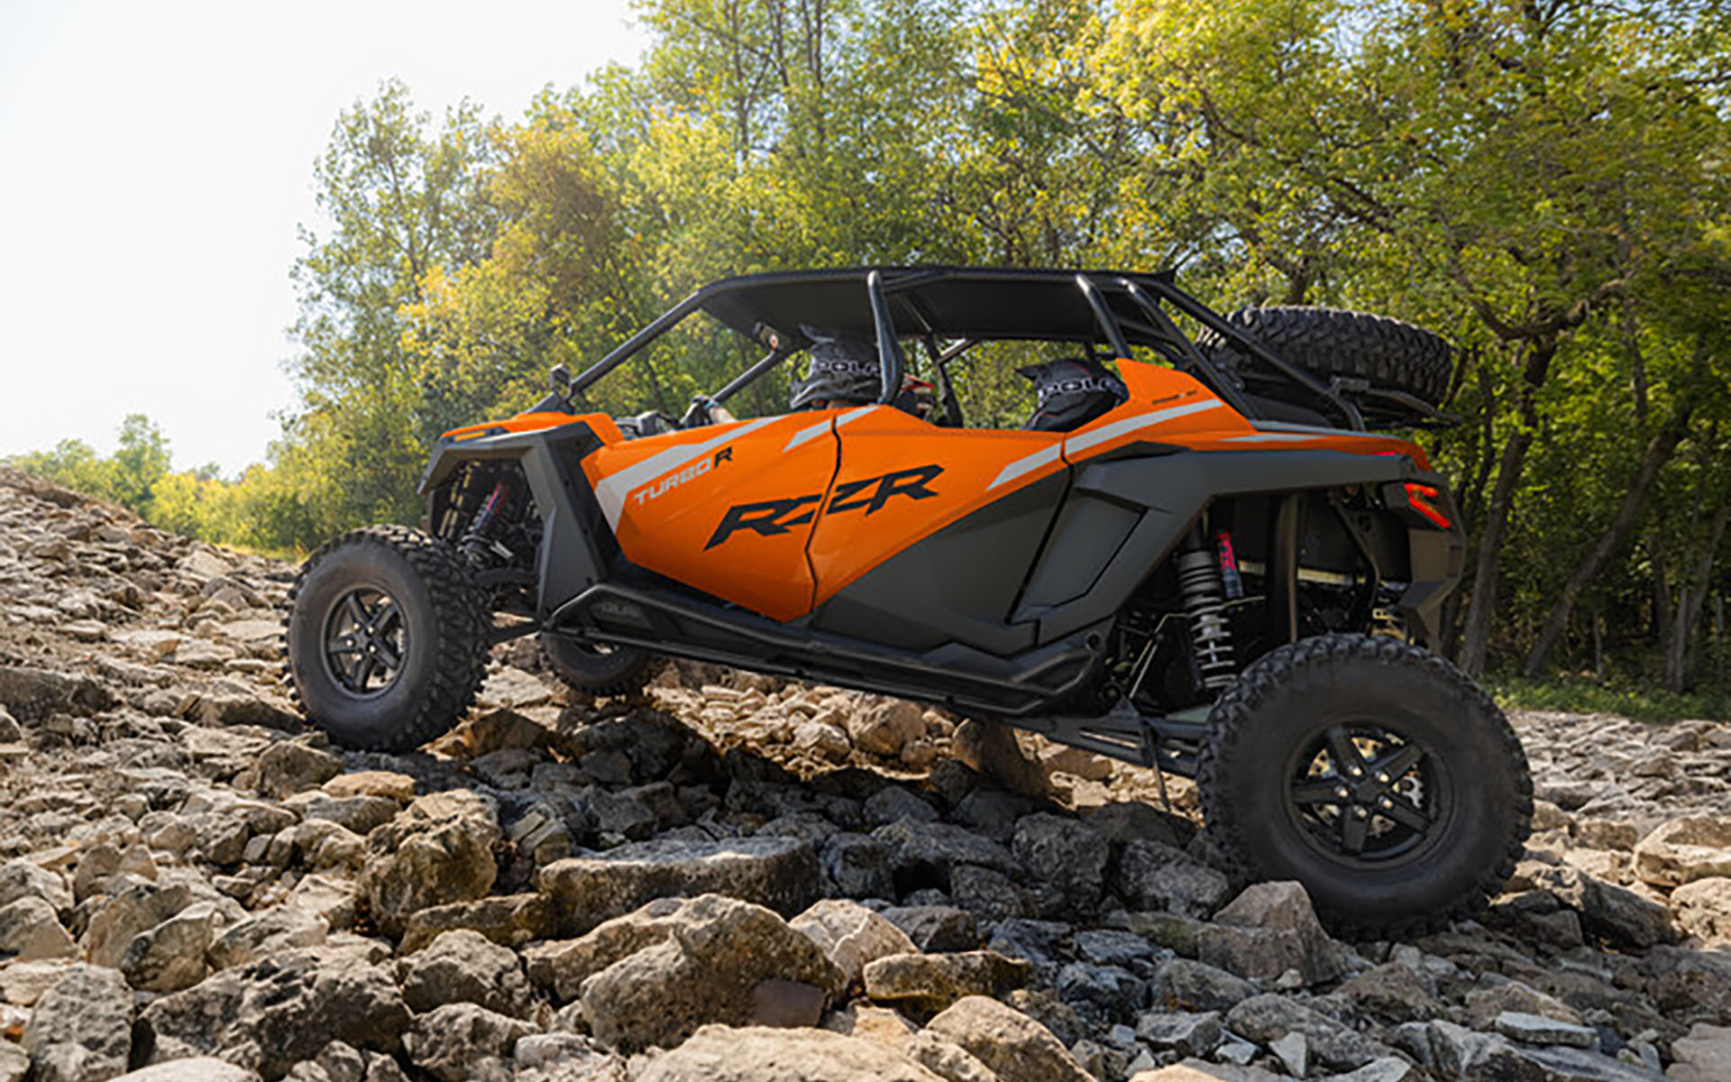
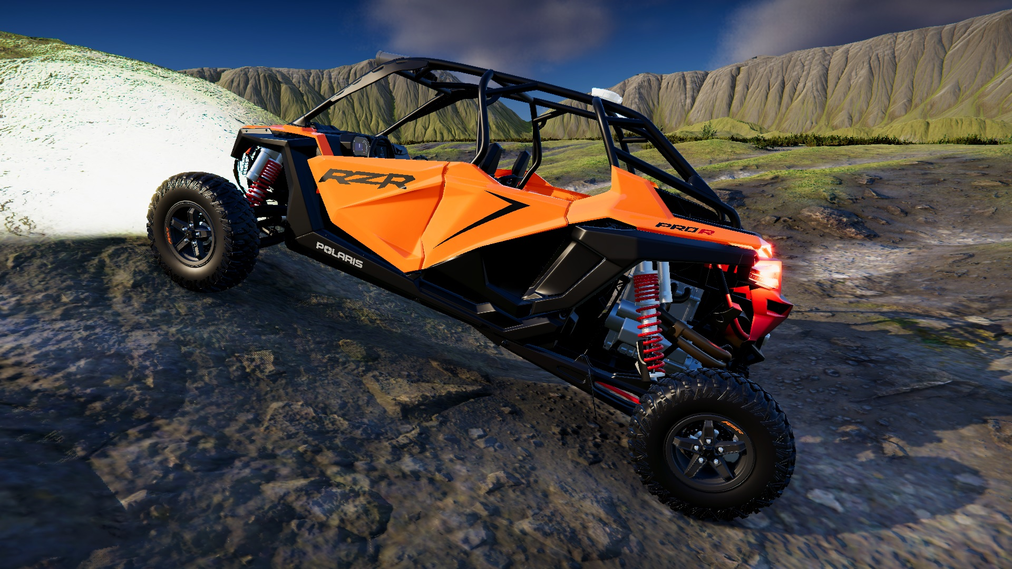
Digital Twin Capabilities of AutoDRIVE Ecosystem
Nigel (Native Scaled Vehicle)
F1TENTH (Scaled Vehicle)
OpenCAV (On-Road Full Scale Vehicle)
RZR (Off-Road Full Scale Vehicle)
Source: AutoDRIVE Ecosystem

Slide 11
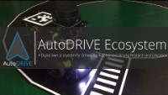
Digital Twin Capabilities of AutoDRIVE Ecosystem
Source: AutoDRIVE Ecosystem

Slide 12
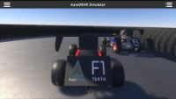
Digital Twin Capabilities of AutoDRIVE Ecosystem
Source: AutoDRIVE Ecosystem

Slide 13
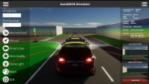
Digital Twin Capabilities of AutoDRIVE Ecosystem
Source: AutoDRIVE Ecosystem

Slide 14
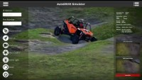
Digital Twin Capabilities of AutoDRIVE Ecosystem
Source: AutoDRIVE Ecosystem

Slide 15

Planned Project Objectives
Set up high-fidelity 3D simulation platform based on real-world vehicle/environment representations (real2sim transfer) [Tanmay]
Set up intelligent agent/environment parallelization framework for accelerating RL training [Tanmay]
Formulate multi-agent reinforcement learning (MARL) problems for: [Tanmay]
Cooperative MARL (e.g., safe intersection traversal)
Competitive MARL (e.g., head-to-head autonomous racing)
Implement the formulated deep reinforcement learning (DRL) pipeline and conduct parallelized training using local/cloud high-performance computing (HPC) resources [Chinmay]
Deploy and analyze the trained policies and procedures to comment on the aspects of “computing and simulation for autonomy” [Chinmay]
Potentially (if time permits) demonstrate simulation to reality (sim2real) transition of the trained policies in a digital-twin framework [Chinmay]
Note: The name in square bracket indicates primary responsibility and NOT contribution. Both members will work together and contribute equally to this project.

Slide 16

Planned Project Objectives
AuE-8930 Capstone Project (Fall 2023)
Task | 10/18 | 10/25 | 11/01 | 11/08 | 11/15 | 11/22 | 11/29 | 12/06
Announcements
Project Proposal
Phase 1
Phase 2
Phase 3
Project Presentation
Project Report

Slide 17
References
T. Samak, C. Samak, S. Kandhasamy, V. Krovi, and M. Xie, “AutoDRIVE: A Comprehensive, Flexible and Integrated Digital Twin Ecosystem for Autonomous Driving Research & Education,” Robotics, vol. 12, no. 3, p. 77, May 2023, doi: 10.3390/robotics12030077
W. Ding, C. Xu, M. Arief, H. Lin, B. Li and D. Zhao, “A Survey on Safety-Critical Driving Scenario Generation—A Methodological Perspective,” in IEEE Transactions on Intelligent Transportation Systems, vol. 24, no. 7, pp. 6971-6988, July 2023, doi: 10.1109/TITS.2023.3259322
S. H. Semnani, H. Liu, M. Everett, A. de Ruiter, and J. P. How, “Multiagent Motion Planning for Dense and Dynamic Environments via Deep Reinforcement Learning,” 2020.
P. Long, T. Fan, X. Liao, W. Liu, H. Zhang, and J. Pan, “Towards Optimally Decentralized Multi-Robot Collision Avoidance via Deep Reinforcement Learning,” 2018
S. Aradi, “Survey of Deep Reinforcement Learning for Motion Planning of Autonomous Vehicles,” 2020.
D. Wang, H. Deng, and Z. Pan, “MRCDRL: Multi-Robot Coordination with Deep Reinforcement Learning,” Neurocomputing, 2020.
X. Zhou, P. Wu, H. Zhang, W. Guo, and Y. Liu, “Learn to navigate: cooperative path planning for unmanned surface vehicles using deep reinforcement learning,” IEEE Access, vol. 7, pp. 165 262–165 278, 2019.

Slide 18
References
K. Sivanathan, B. K. Vinayagam, T. Samak, and C. Samak, “Decentralized Motion Planning for Multi-Robot Navigation using Deep Reinforcement Learning,” in 2020 3rd International Conference on Intelligent Sustainable Systems (ICISS), 2020, pp. 709–716, doi: 10.1109/ICISS49785.2020.9316033
F. Fuchs, Y. Song, E. Kaufmann, D. Scaramuzza, and P. Durr, “Super-Human Performance in Gran Turismo Sport Using Deep Reinforcement Learning,” IEEE Robotics and Automation Letters, vol. 6, no. 3, pp. 4257–4264, 2021.
Y. Song, H. Lin, E. Kaufmann, P. Durr, and D. Scaramuzza, “Autonomous Overtaking in Gran Turismo Sport Using Curriculum Reinforcement Learning,” 2021.
C. V. Samak, T. V. Samak, and S. Kandhasamy, “Autonomous Racing using a Hybrid Imitation-Reinforcement Learning Architecture,” 2021. [Online]. Available: https://arxiv.org/abs/2110.05437
J. Betz, H. Zheng, A. Liniger, U. Rosolia, P. Karle, M. Behl, V. Krovi, and R. Mangharam, “Autonomous Vehicles on the Edge: A Survey on Autonomous Vehicle Racing,” IEEE Open Journal of Intelligent Transportation Systems, vol. 3, pp. 458–488, 2022.

